Slide 1
Parallel Processing
Parallel Processing
Ron Coleman, Ph.D.

Slide 2
Learning objectives for this week
Parallel processing & its limits

Slide 3
What is parallel processing?
Use of concurrency to speed up application
Concurrency in...
Hardware—Processors, memory, network
Software— algorithm, languages, DBs
Goal: exploit these as best possible

Slide 4
How is parallel processing used?
See some examples here.
National bragging rights here.

Slide 5
Why study parallel processing?
Every modern CPU is multicore
Thus, inherently parallel processors
Many are supercomputers
While opportunities are abound…
1) “no free lunch” dilemma
2) how to program these machines?

Slide 6
Parallel vs. Distributed processing
Tight coupling
Multicore
Scale-up
Parallel
Distributed
Threading
Speedup
Throughput
Reliability
Loose coupling
Scale-out

Slide 7
Parallel processing limitations
Software development
Algorithms
Hardware
Languages
Models
Testing
Debugging
Bottleneck analysis
Concurrency hazards
Number cores/CPUs
Memory latency
Pathlength
Network bandwidth

Slide 8
Von Neumann bottleneck
Stored program concept
Instructions
Data
Main memory
CPU
front-side bus
IO devices

Slide 9
Some non-von Neumann machines
U of Illinois ILLIAC-IV
Goodyear Massively Parallel Processor
Manchester Data flow machine
Intel hypercube
Systolic arrays
Thinking Machines Connection Machine
(1966)
(1983)
(1985)
(1985)
(1985)
(1985)

Slide 10
Speedup & efficiency
T₁ = time on uniprocessor
T_{N} = time on system with N processors
R = T₁ / T_{N}
e = R / N
overhead = 1 - e

Slide 11
Uniprocessor
T₁ = 1 (one minute, hour, day, whatever)
T_{N} = 1 (recall: N=1)
R = T₁ / T_{N}
= 1 / 1 = 1
e = R / N = 1 / 1 = 1 = 100%
overhead = 1 - e = 0%

Slide 12
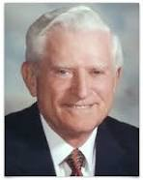
Algorithm limits
First formulated by G. Amdahl (1967)
Former IBMer, started Amdahl Corp.
Defined maximum speedup potential
Argued parallelism not justified
1922 - 2015

Slide 13
Amdahl’s law
s = fraction of task not parallelizable
p = fraction of task parallelizable
1 = p + s
T₁ = s + p = 1
So...what is T_{N} for N processor system?
T_{N} = s + p / N

Slide 14
Amdahl’s law
So what is R (speedup)?
R = T₁ / T_{N}
R = (s + p) / (s + p / N)
R = 1 / (s + p / N )
R = 1 / (s + p / N) = 1 / s
{ lim N →∞ }

Slide 15
Example: 18-core iMac
Jan 2018
Suppose s=25% -- not unreasonable.
Thus, p=75%
According to Mr. Amdahl, R = 1/s = 1/0.25 = 4
e = R/N = 4/18 or 22%
Thus, he’s right: why spend $17K?
i.e., ~80% or $13K wasted.

Slide 16
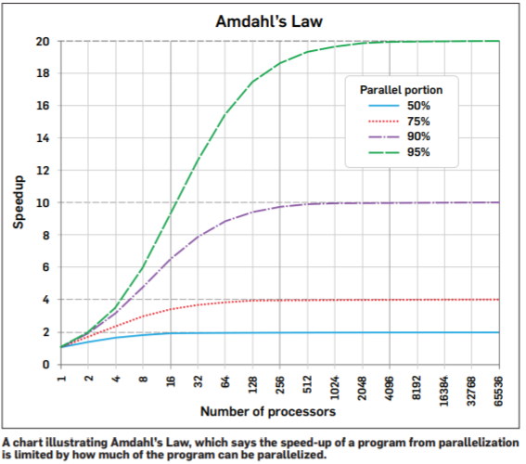
Amdahl’s law
Kirkpatrick, K., “Parallel Computational Thinking,” CACM, Dec 2017

Slide 17
Amdahl’s assumptions
T₁ = s + p = 1 implies what?
Problem size is fixed.
Usually run a bigger problem on bigger, more powerful machine
Time is constant, not problem size.

Slide 18
Gustafson's law (1988)
T_{N} = 1
T₁ = s + p * N
R = T₁ / T_{N}
R = (s + p * N ) / 1
R = s + p * N
=> Linear speedup!

Slide 19
Gustafson's law
e = R / N = (s + p * N ) / N = s/N + p
e = R / N
e = (s + p * N ) / N
e = s / N + p

Slide 20
Gustafson's law
e = s / N + p = p
Efficiency limited to problem (ie, amount of parallelism opportunity).
Amortize serial tasks over a long running parallel tasks
{ lim N →∞ }

Slide 21
Software limits
By far most difficult programming
Imperative languages simplest but...
Based von Neumann architecture
a) Shared memory, b) side-effects, c) locking
1. Expensive in time
2. Inherently sequential, not parallel
3. Fraught w. concurrency hazards

Slide 22
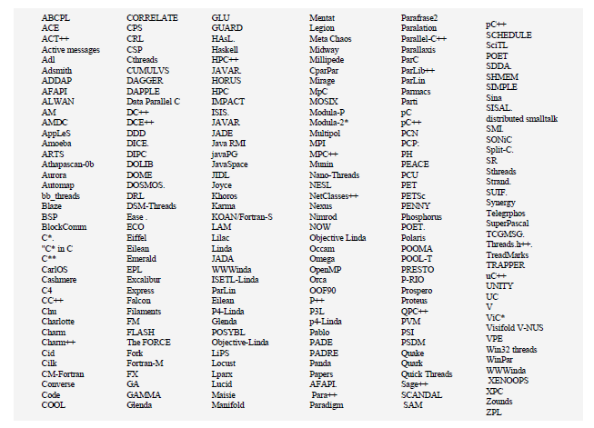
Parallel programming languages (as of 90s)
http://parlang.pbworks.com/f/programmability.pdf

Slide 23
Functional programming
Functions: f(x) → y x,y read-only copies: nothing to lock!
First-class objects: x could be function Uses higher-order functions.
Follows lambda calculus.
Developed in 1930s -- equivalent to Turing machine in computability and it’s mathematically expressive

Slide 24
FP
Making comeback, decades nearly forgotten.
Scala, Java, Swift, Clojure, etc.
Why now?
Scales
Supported by multicore

Slide 25
Scala
Blends object & functional styles.
Four approaches to parallel programming
JVM language
Cleans up Java syntax / patterns

Slide 26
Scala parallelism
Threads
Actors
Futures/Promises
Parallel collections
Task-level
Data-level

Slide 27
Thinking parallel
Suppose you wanted to multiple some numbers by 2 & add results:
{ 1, 3, 4, 5, 12, 2, 7, 9 } * 2 => 2+6+8+10+24+2+14+18 = 84
Do it sequentially in Java, no problem: O(n)

Slide 28
Sequential mult-add (Java)
public class SequentialMultAdder {
public static void main(String[] args) {
int[] nums = { 1, 3, 4, 5, 12, 2, 7, 9 };
int sum = 0;
for(int n: nums) {
sum += 2 * n;
}
System.out.println(sum);
}
}

Slide 29
Sequential mult-add (Scala)
object SequentialMultAdder1 extends App {
val nums = List(1, 3, 4, 5, 12, 2, 7, 9)
val total = nums.foldLeft(0) { (sum, n) => sum + 2*n }
println(total)
}

Slide 30
Mapreduce
Well suited to this problem
Map transforms (or “maps”) data: n → 2*n
Reduce combines partial results: sum
“+” reduces (a,b) to single value

Slide 31
Sequential mult-add (Scala)
object SequentialMultAdder2 extends App {
val nums = List(1, 3, 4, 5, 12, 2, 7, 9)
val sum = nums.map{n => 2*n}.reduce{(a,b) => a+b }
println(sum)
}

Slide 32
Parallel mult-add
2*1
2*3
2*4
2*5
2*12
2*2
2*7
2*9
O(1)
A
+
B
+
C
+
D
+
E
+
F
+
O(log n)
+
G
sum

Slide 33
Parallel mult-add numbers (Scala)
object ParallelMultAdder extends App {
val nums = List(1, 3, 4, 5, 12, 2, 7, 9)
val sum = nums.par.map{n => 2*n}.reduce{(a,b) => a+b }
println(sum)
}

Slide 34
Parallel collections: free lunch?
If you think functionally, you can do parallel!
Just add .par to convert to parallel collection
Scala does rest via hyper-threads

Slide 35
ParaScale (github.com)
Threads, actors, futures, parallel collections
ParaBond
MongoDB

Slide 36
Summary
Amdahl’s law assumes problem size fixed and speedup is limited by s, the serial component.
Gustafson's law assumes time is fixed and speedup is linear in N, number of cores.
FP is well-suited to parallel programming.
Scala is a JVM language that supports four concurrency models.
ParaScale is a base project for exploring parallelism.

Slide 37
Tasks to do this week
Work on forum question #1 in Piazza.
Complete Lab #1
Start Lab #2
due this week -- see Assignments in iLearn.
due next week -- see Assignments in iLearn

Slide 38
Next week topics
Intro to Scala

